Slide 1
Project Presentation
on
Chandigarh Tourism Website
Presented by:
Saurabh Banga_(1813986020)
Harish Chander_(1813986009)
Rohan Mondal_(1813987016)
Shashank Sahdev_(1813987020)
Under the supervision
of
Shankar S Aggarwal
Department of Computer Applications

Slide 2
Contents
Introduction:- Our Project is about the Tourism in Chandigarh. In Our website We are exploring best Places of Chandigrah, Where tourist can enjoy and have s good time with there family and friend. In our website we are providing the facility of booking( Hotel,Resort and mode of Transport).Our website have a wallet Page where People can collect there Reward. In our website People can add there images and explore more by writing blog of places they visited.

Slide 3
Contents
Problem Statement(s):-
Chandigarh is a beautiful city. People are coming in Chandigarh to see the Sukhna Lakhe, Rock Garden, Rose Garden, Elante Mall etc. But there is no such website where Tourist are book Hotel, Booking Cab in a good amout and visit Chandigarh. There is no website provide the family package in small amout and rewards to user.

Slide 4
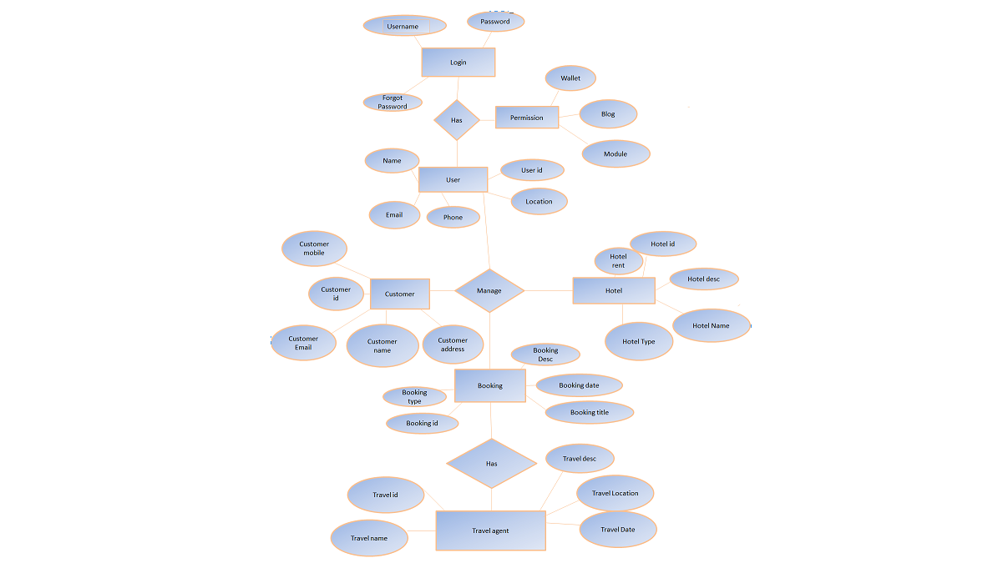
Contents
Project Flow Diagram:-

Slide 5
Contents
Tools/Methods:-
Front End:- Tool:- Visual Studio
Html
CSS
Java script
SAS
Backend:- Tool:- Xampp
PHP

Slide 6
Contents
Implementation and Specifications:-
In our project Specification is We are offering Tourist to Complete Family Pacakage in this package the food cost, cab cost, Hotel booking cost are in very small amout. In our projrect we are providing all facility to tousrist in good amout.

Slide 7
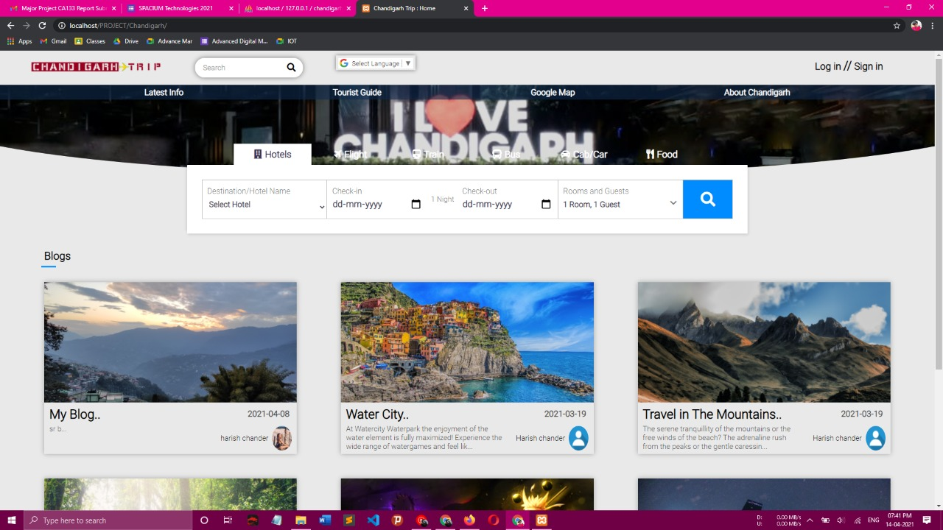
Contents
Result /Screenshots(if any):-

Slide 8
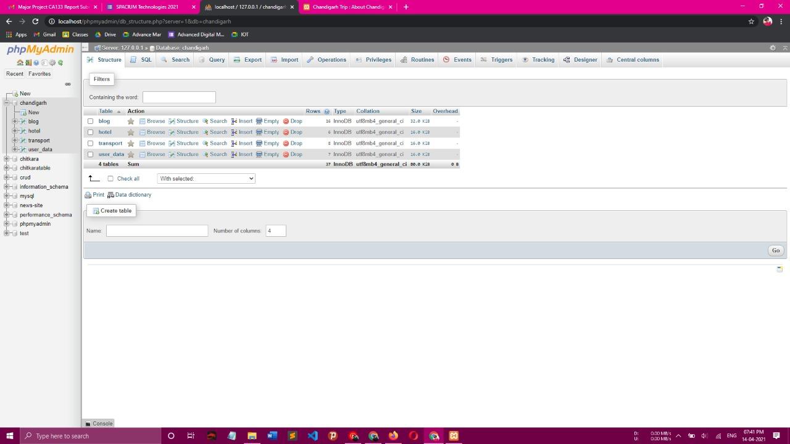
Contents
Result /Screenshots(if any):-

Slide 9
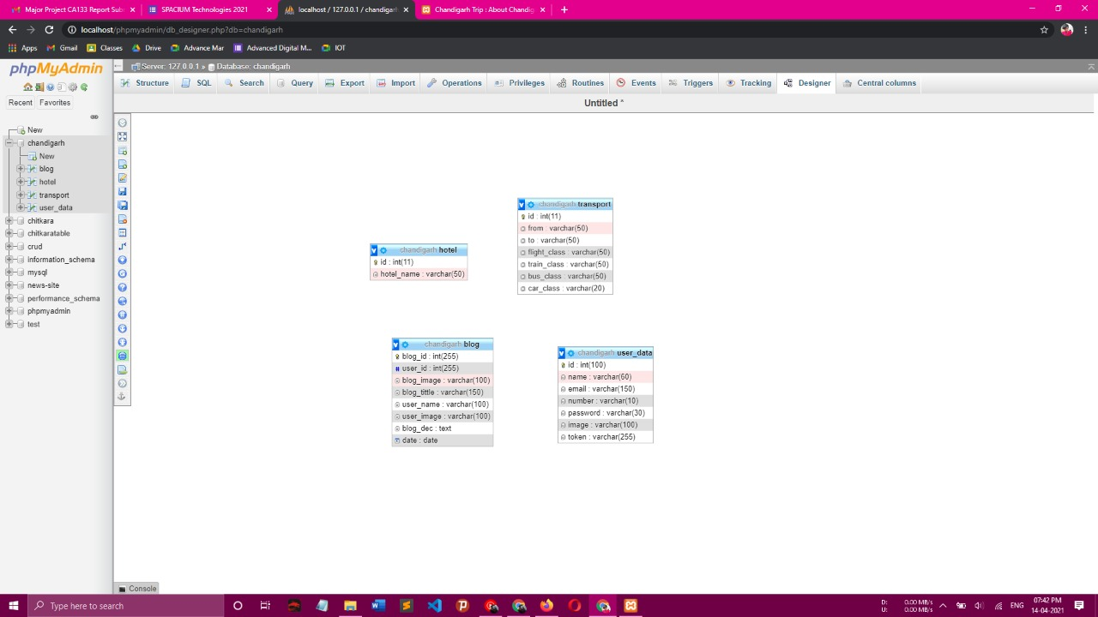
Contents
Result /Screenshots(if any):-

Slide 10
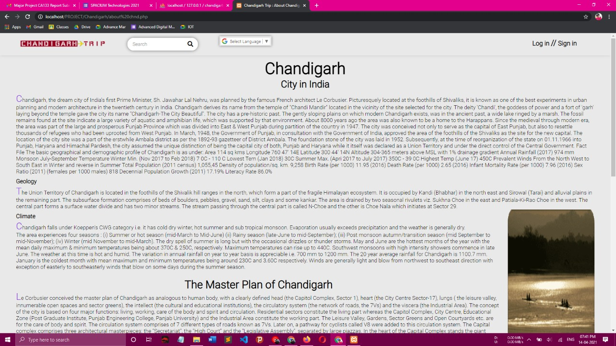
Contents
Result /Screenshots(if any):-

Slide 11
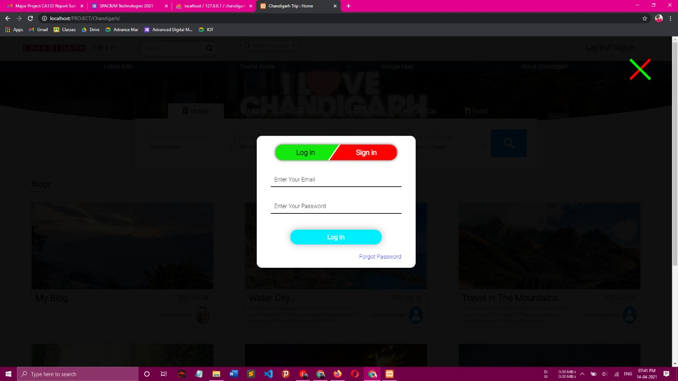
Contents
Result /Screenshots(if any):-

Slide 12
Thank You

